Slide 1

Loan Defaulting predictive model
Alin-Constantin Paraschiv

Slide 2








From standard campaigns to predictive leads scoring
Loan 1
Loan 2
Client information
Around 17 features about the loan and borrower were analysed
Predictive model
Predicting the loan’s probability to become defaulted
Loan 3
Actions
Prioritize most probable clients to become incapable of repaying the loan and include them in specific campaigns
Scored leads
Assign for each loan a default probability

Slide 3
Timeline
Predict if the borrower will become incapable of repaying a loan in 2 months
Model will run monthly (EOM) in PROD
Training
Cooldown
Target
12M
1M
1M

Slide 4
Based on the technical performance, the model’s predictive power is a good one
Only 12% of the loans have class 1 (defaulted) which means that we have an unbalanced dataset
Area Under ROC: 0.75
The model has a 75% chance to distinguish between a loan that will become defaulted and one that will not
0.5-0.6 Unsatisfactory; 0.6-0.7 Satisfactory; 0.7-0.8 Good; 0.8-0.9 Very Good; 0.9-1 Excellent

Slide 5
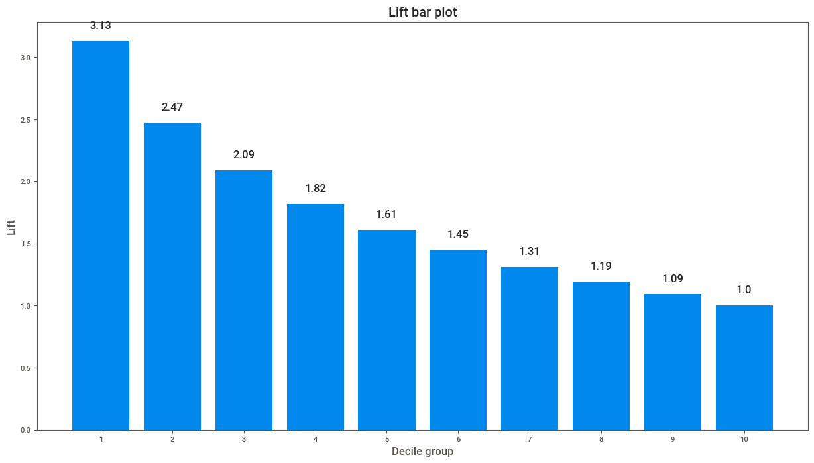
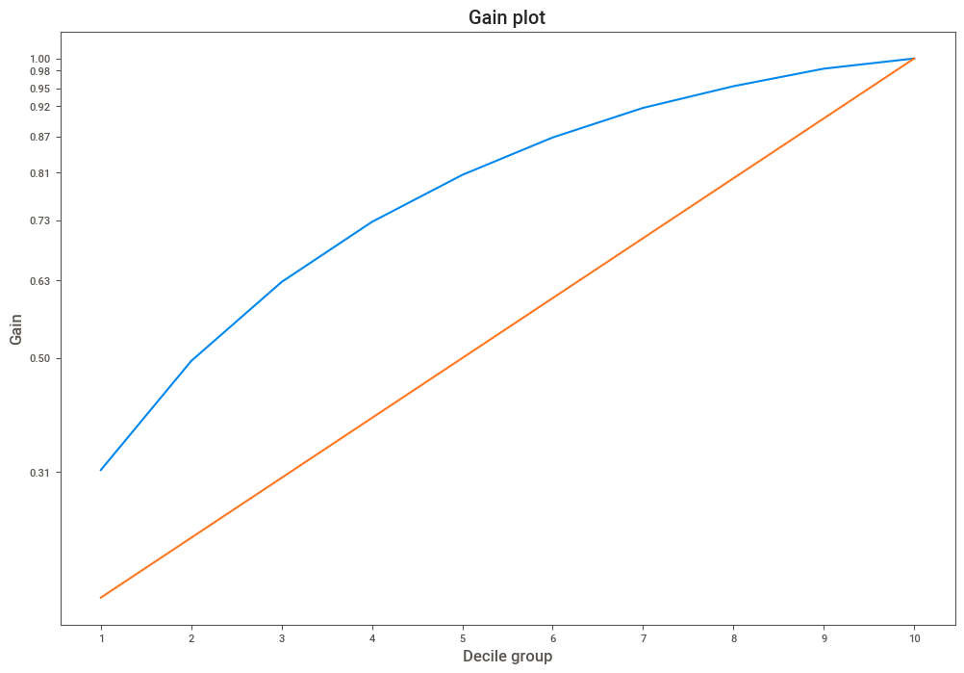
Top 4 deciles of the scored model capture 73% of the clients who are likely to become incapable to repay their loan
It shows the percentage of targets reached when considering a certain percentage of the population with the highest probability to be target according to the model
It shows how many times a campaign will be better compared to a random selection

Slide 6
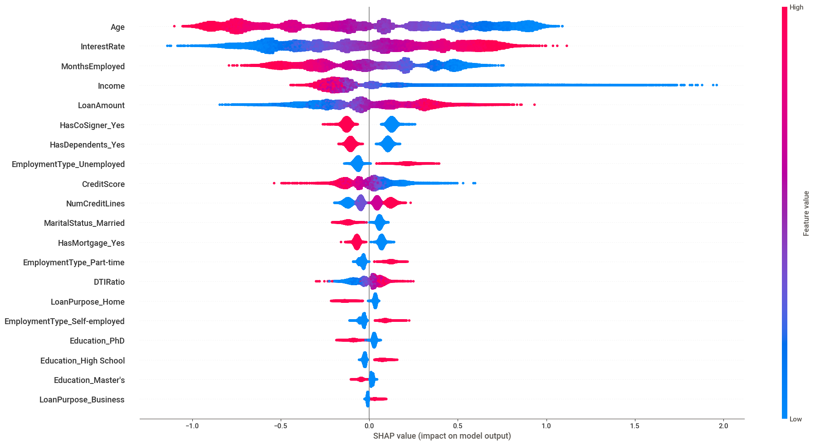
Customers more likely to become incapable of repayment are younger, have a higher Interest Rate and have a lower Income
How to read data:
The color shows us the feature value: high values are red and low values are blue
The shap value shows us the impact: negative values lead to a decrease in probability, while positive values lead to an increase in probability
The features order in the chart show us the rank in terms of impact

Slide 7
Thank you!
Any questions so far?

